Slide 1
Modeling adaptive evolution

Slide 2
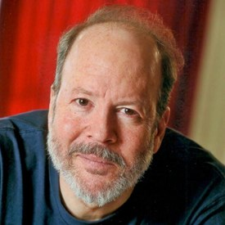
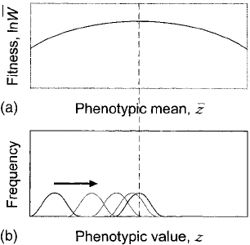
Genetic Drift + Natural Selection
Genetic drift only:
Δz = G/Ne * dW
Genetic drift + Natural selection to a Gaussian adaptive peak:
Δz = G/(ω + P)*(θ - z) + G/Ne * dW
Russ Lande
Genetic variance
Distance from the optimum
Width of the adaptive landscape

Slide 3
Ornstein-Uhlenbeck Process
Δz = α(θ - z) + σ dW
α - Rate of adaptation
Units: (1/time)
σ - Rate of stochastic evolution
Units: trait units/time
θ - Phenotypic optimum

Slide 4
Ornstein-Uhlenbeck process
α = 0.1
σ²= 1

Slide 5
Ornstein-Uhlenbeck process
α = 0.000001
σ²= 1

Slide 6
Ornstein-Uhlenbeck process
α = 0.1
σ²= 1

Slide 7
Ornstein-Uhlenbeck process
α = 0.1
σ²= 1
α = 1
σ²= 10

Slide 8
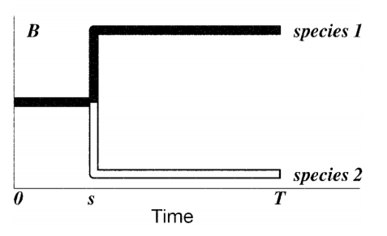
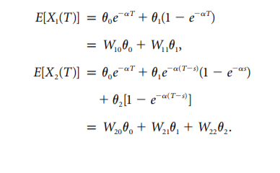
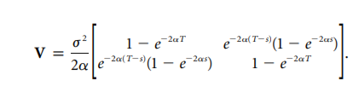
Butler & King 2004

Slide 9
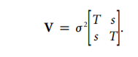
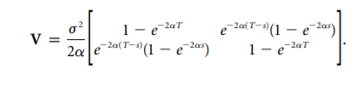
Useful parameterization:
Stationary Variance = σ²/(2α)
The amount of variance among a set of lineages with an infinite amount of time evolving at the optimum
Phylogenetic half-life = ln2/(2α)
The expected amount of time for a lineage to get halfway to the optimum

Slide 10
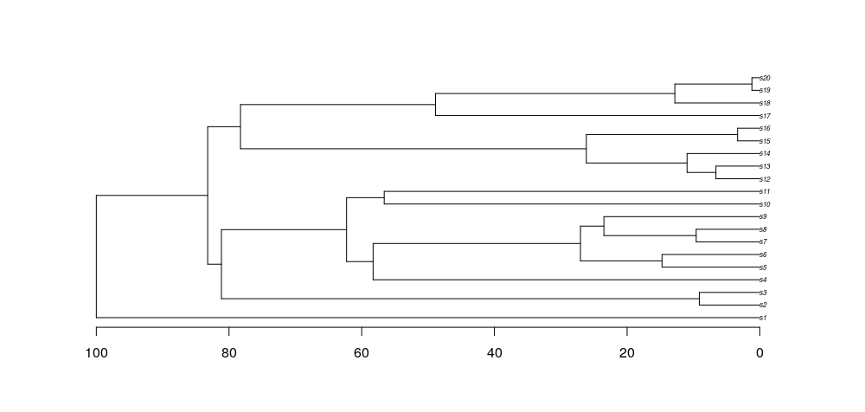
Interpreting half-life
ln2/α
BM-like
White noise
OU

Slide 11
Phylogenetic signal - What does it mean?
Pagel's Lambda
Blomberg's K
Phylogenetic halflife

Slide 12
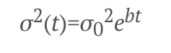
AC/DC model
BM, but with a declining rate parameter:
If b is negative, declining rates (i.e. Early burst)
If b is positive, increasing rates (late bursts, not identifiable from OU in ultrametric trees)

Slide 13
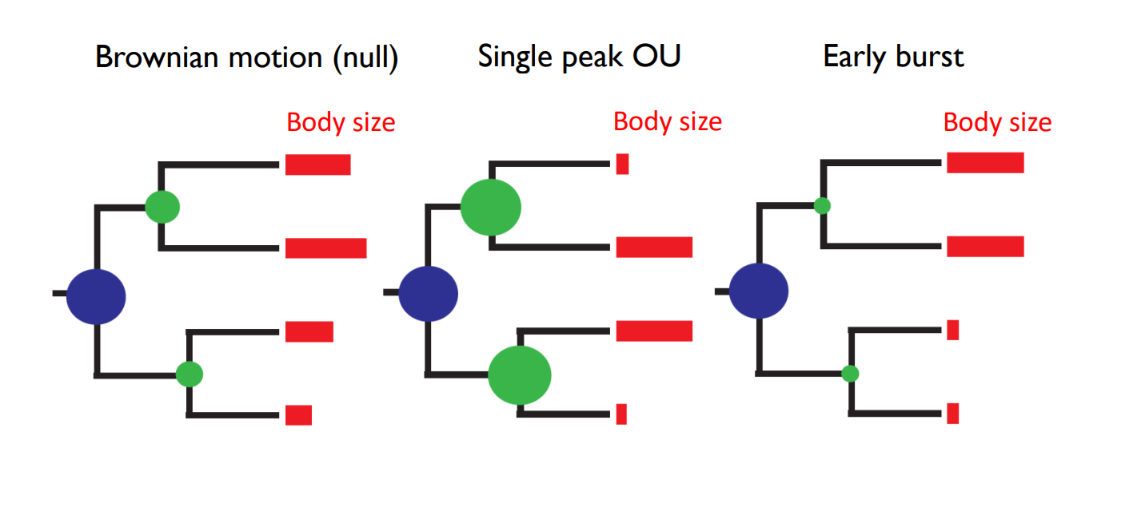
Early Burst -> Brownian Motion -> Ornstein-Uhlenbeck

Slide 14
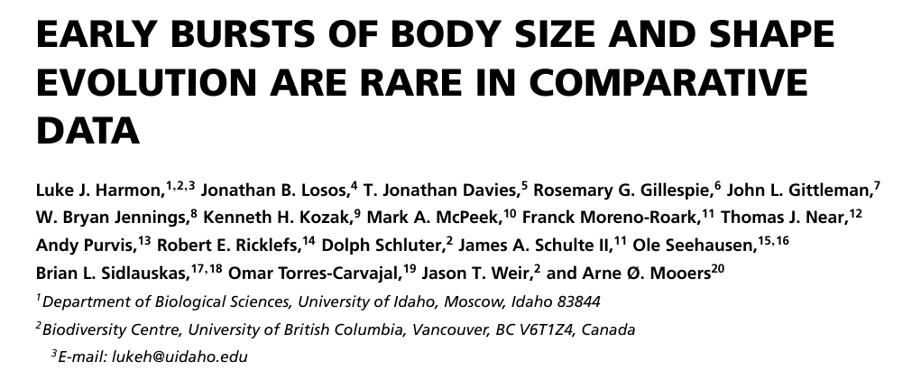
Early Burst -> Brownian Motion -> Ornstein-Uhlenbeck

Slide 15
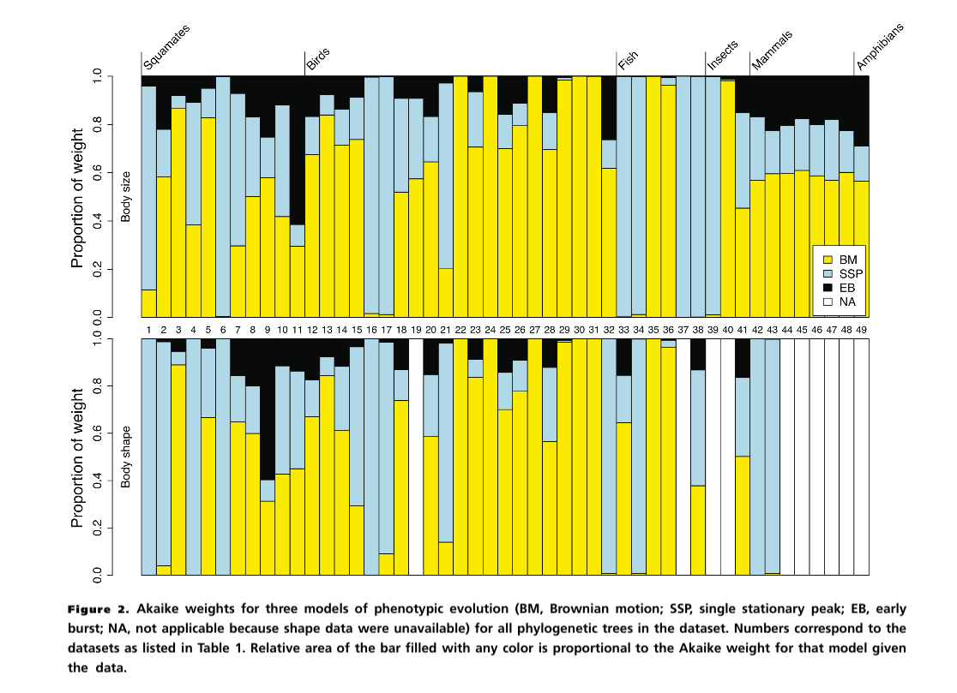
Early Burst -> Brownian Motion -> Ornstein-Uhlenbeck

Slide 16
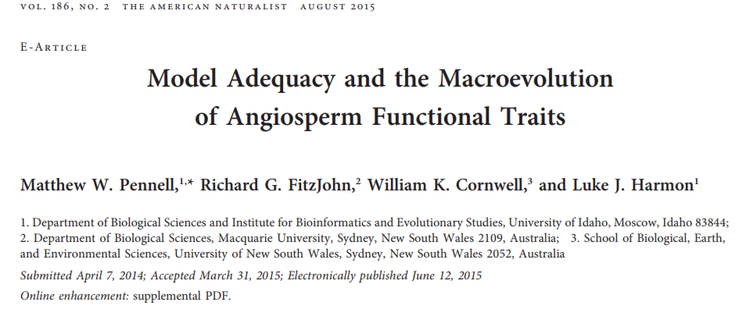
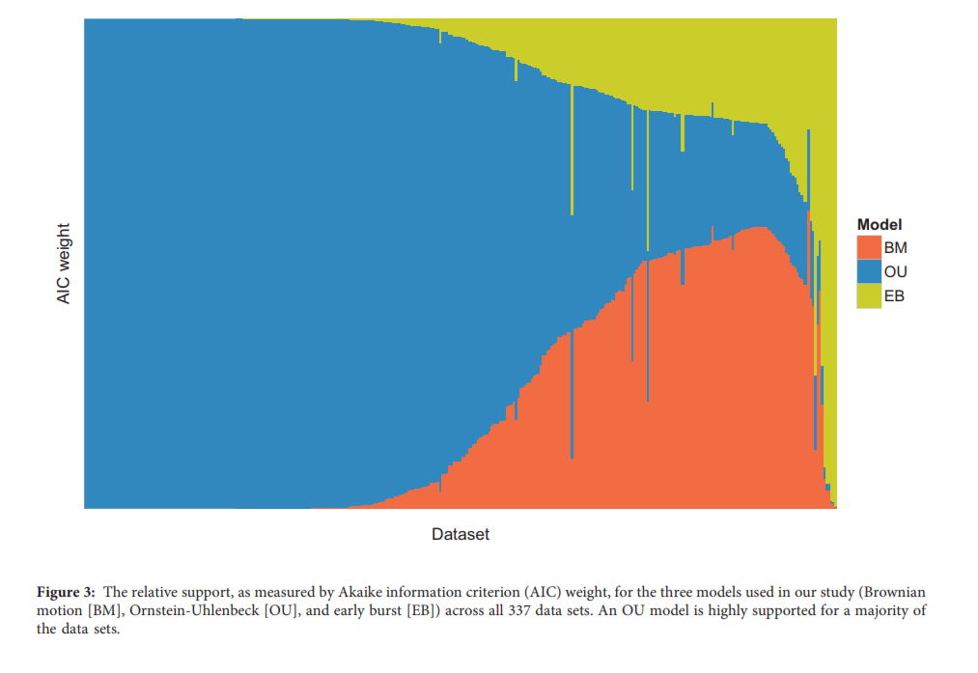

Slide 17
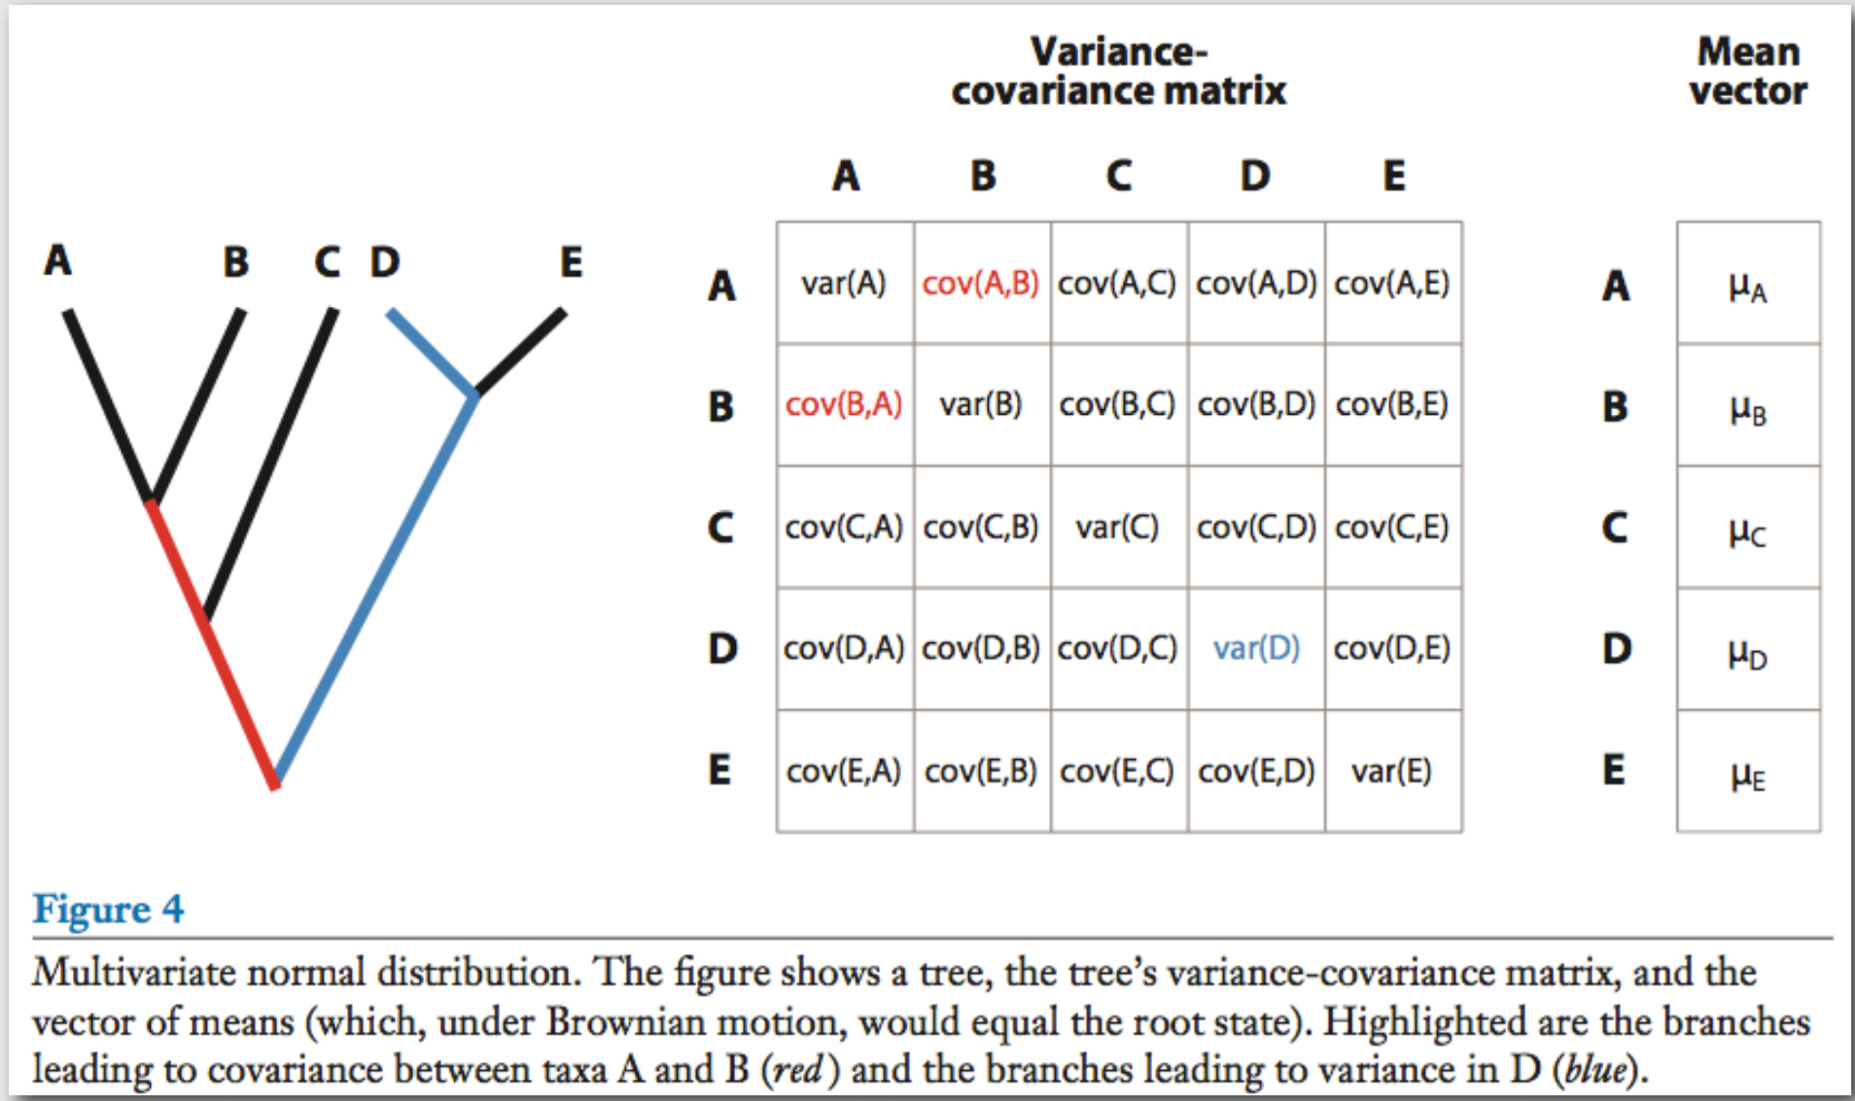

Slide 18
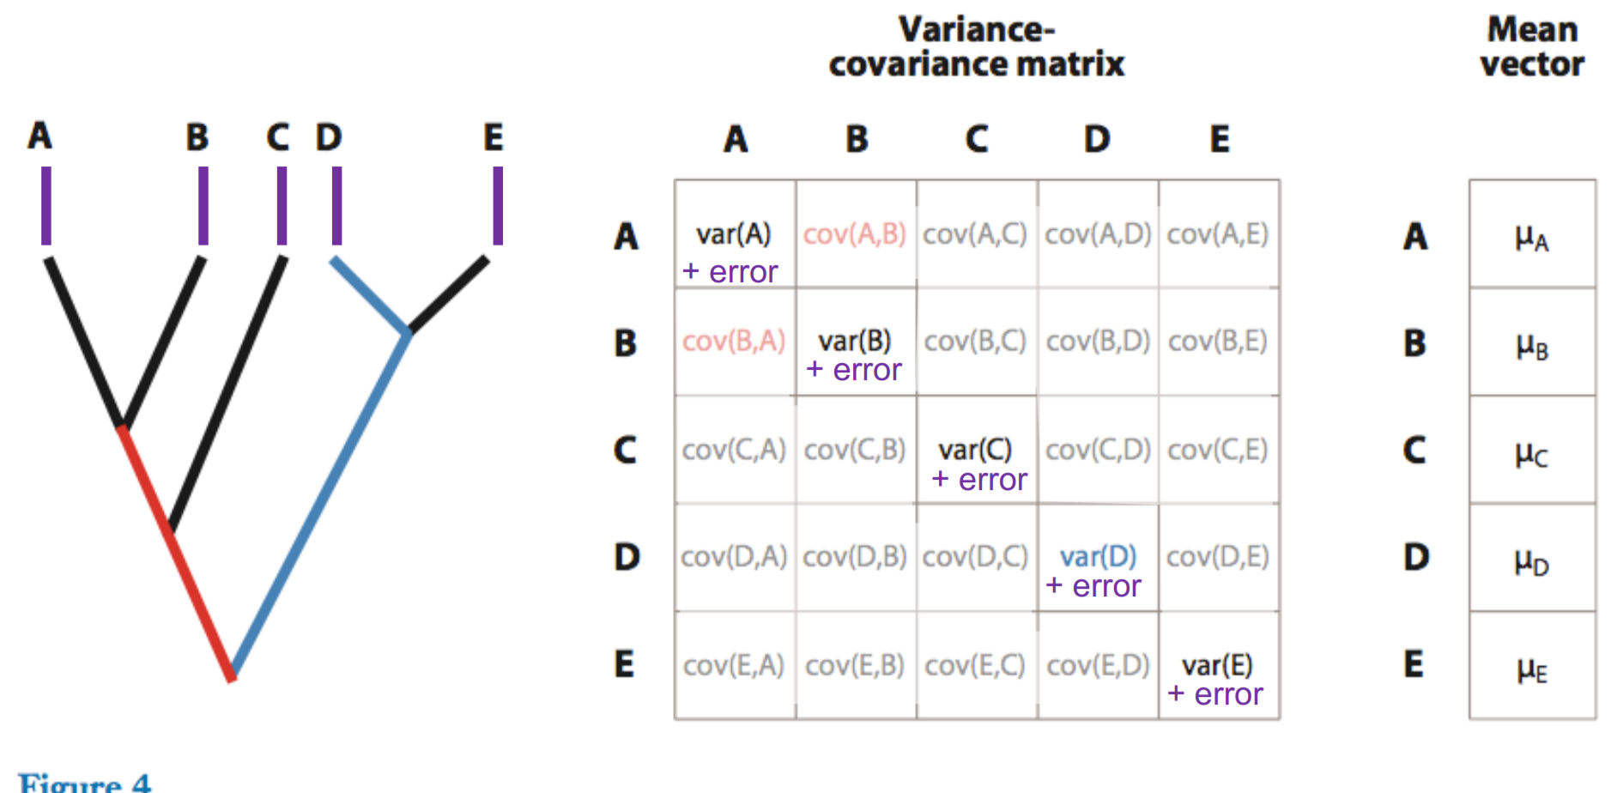
Why we must account for “measurement” error

Slide 19
EB BM OU WN
α = 0
halflife=∞
α
α =∞
halflife=0
OU models
High phylogenetic signal
No phylogenetic signal
ACDC model
(EB/OU)
-
+
0
Contrast
Node Height
test
Root Tip
Node age
Root Tip
Node age
Root Tip
Node age
Measurement error +
“Biological error”

Slide 20
PGLS + OU : Not a full OU model
Statistically, much like PGLS + Lambda
Appropriate only for “Allometric-type” relationships between predictor and response
OU model in variance, but not in mean (instantaneous adaptation)
Phylogenetic half-life with no predictors =
measure of phylogenetic signal
..................................... with predictors =
measure of REMAINING phylogenetic signal in residuals

Slide 21
What are macroevolutionary landscapes?
What does alpha measure?
A: Strength of Natural Selection(?)
Problem: What if we measure selection pulling a species AWAY from the macroevolutionary optimum in a natural population?
(This is VERY COMMON!)

Slide 22
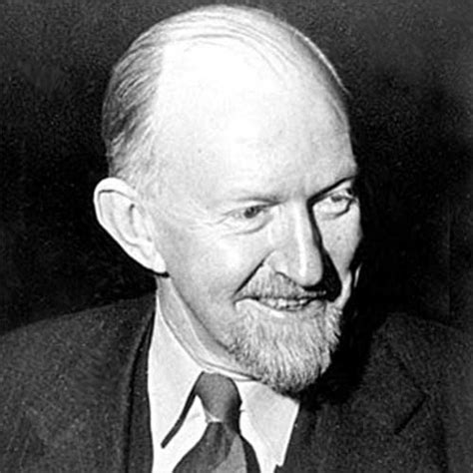
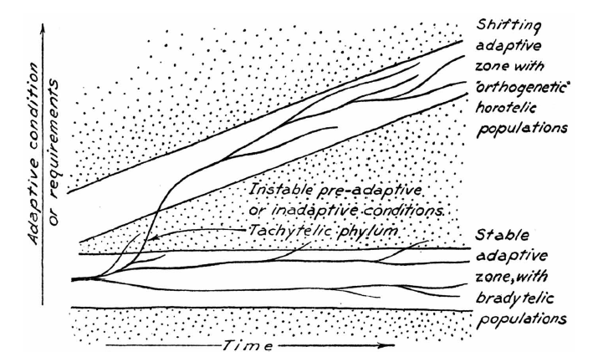
Simpson's Adaptive Zones

Slide 23
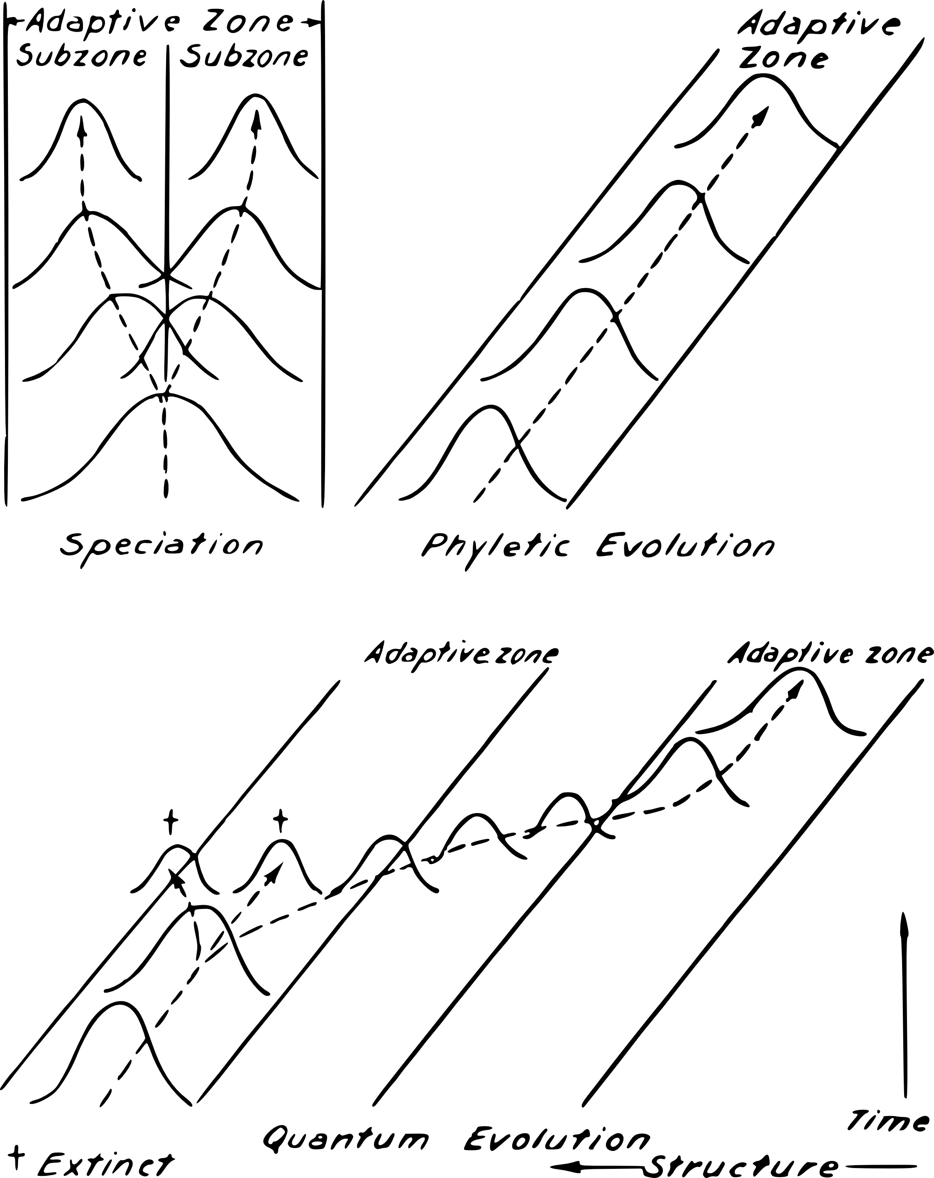

Slide 24
Next time: Shifting adaptive zones

